Slide 1
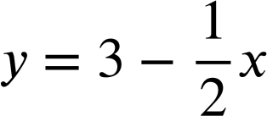
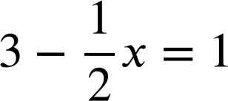
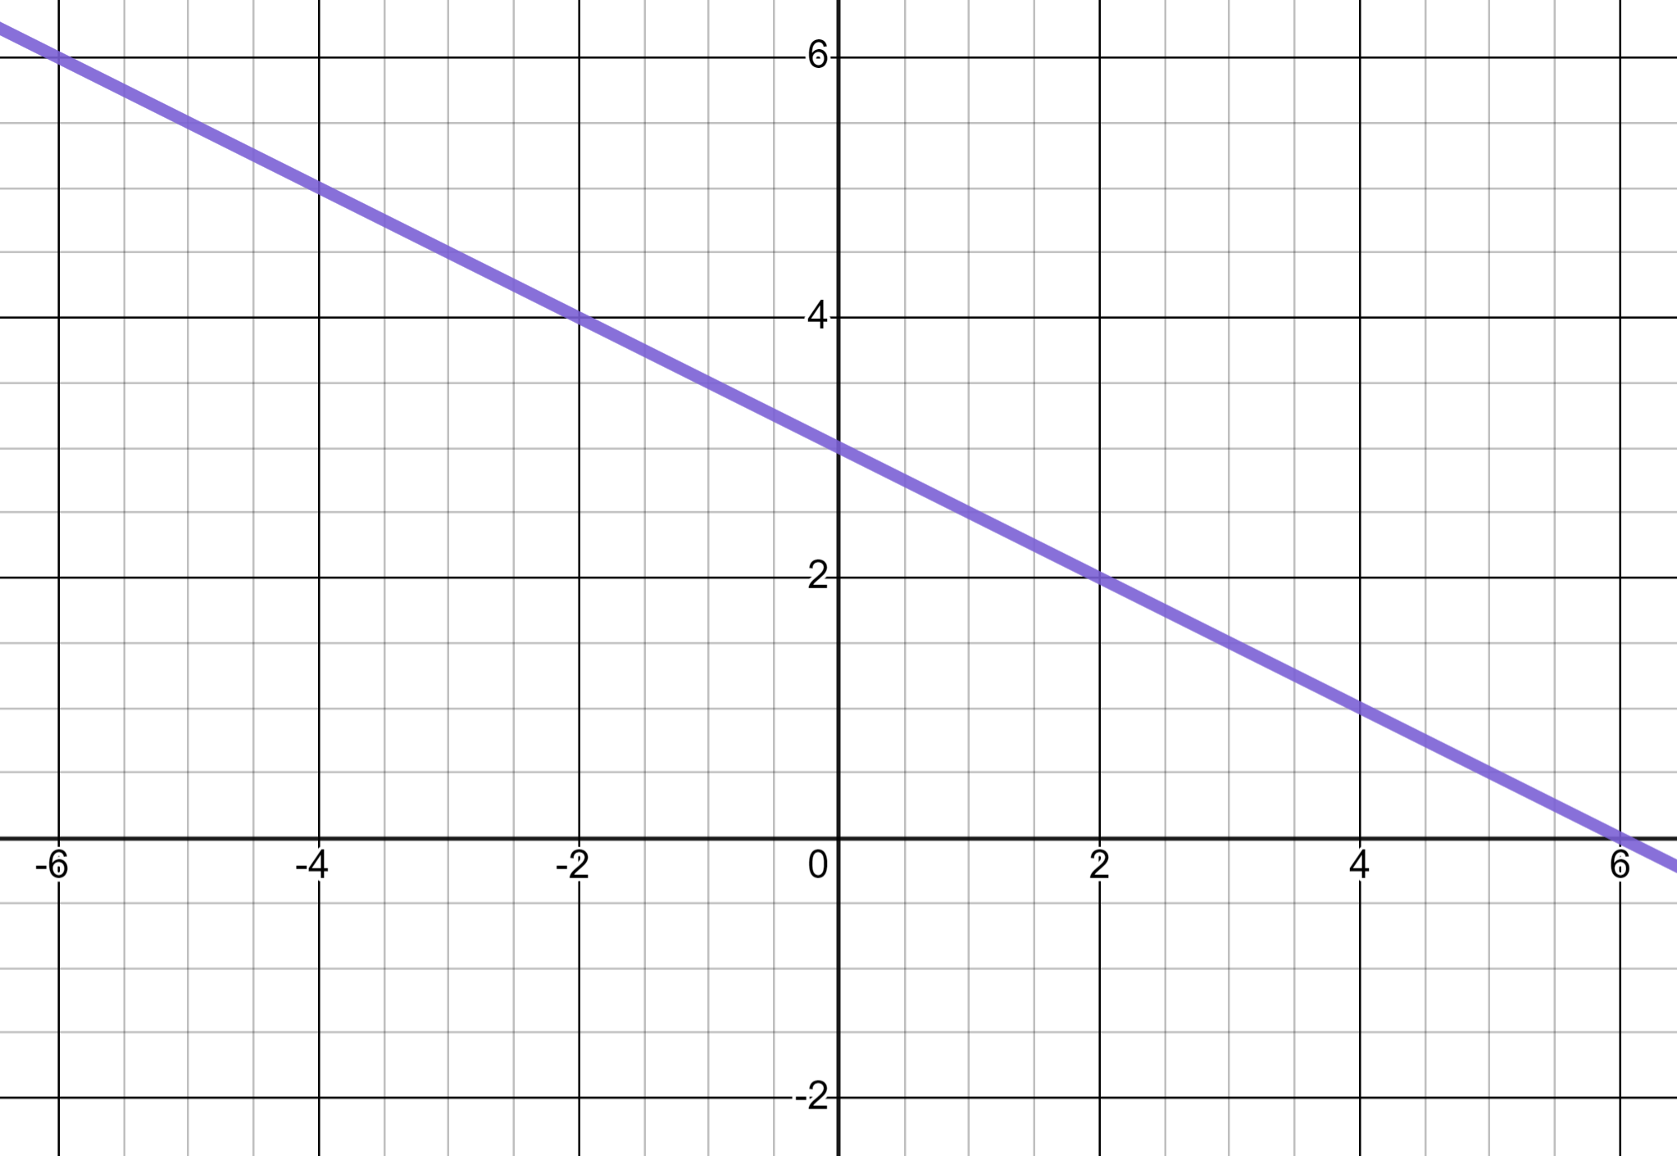
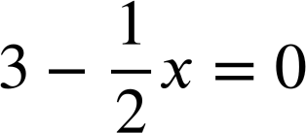
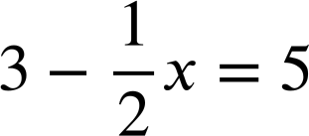
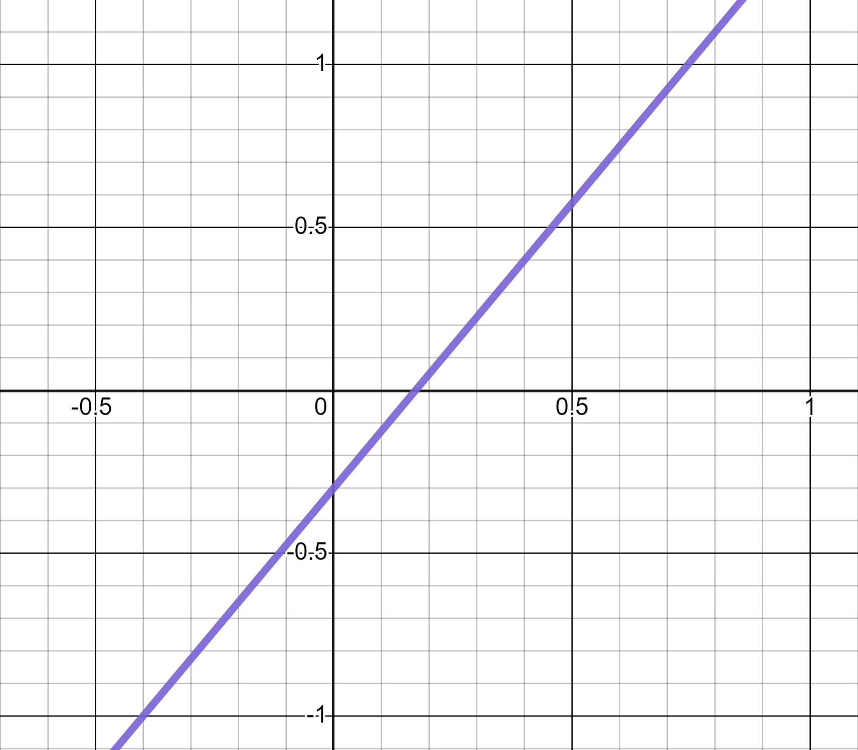
Reading from graphs
Task A: Reading from linear graphs
1) Use this graph of to solve these equations.
a)
y
b)
c)
x
2) Use this graph of y = 1.75x − 0.3 to calculate:
a) 1.75 × 0.8 − 0.3
y
b) 1.75 × 0.4 − 0.3
x
c) 1.75 × −0.4 − 0.3

Slide 2
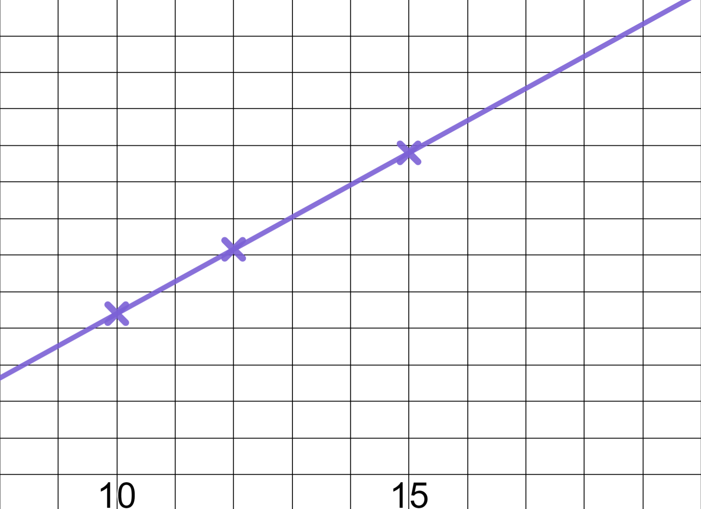
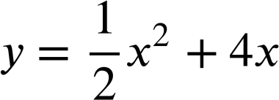
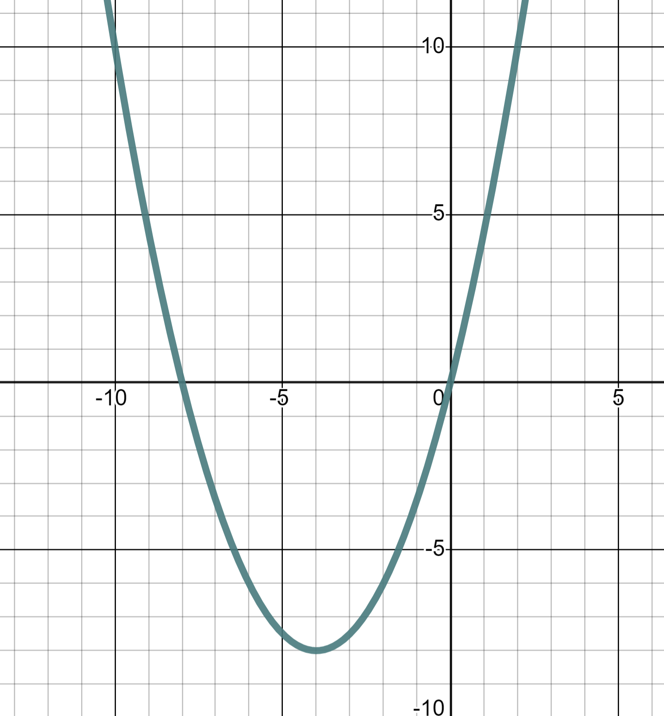
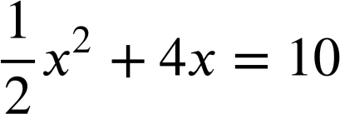
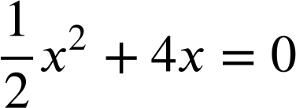
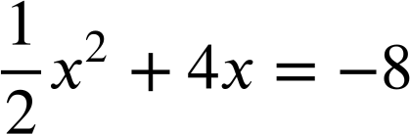
Reading from graphs
3) The Oak pupils plot their age against how many books they have read and find a linear relationship.
a) Use the graph to estimate the age of a pupil who has read 400 books.
600
Books read
500
400
b) Use the graph to predict how many books a pupil will have read by the time they reach 18.
300
200
100
Age (yrs)
Task B: Reading from quadratic graphs
1) This is the graph of the quadratic equation
y
Use the graph to solve:
a)
x
b)
c)

Slide 3
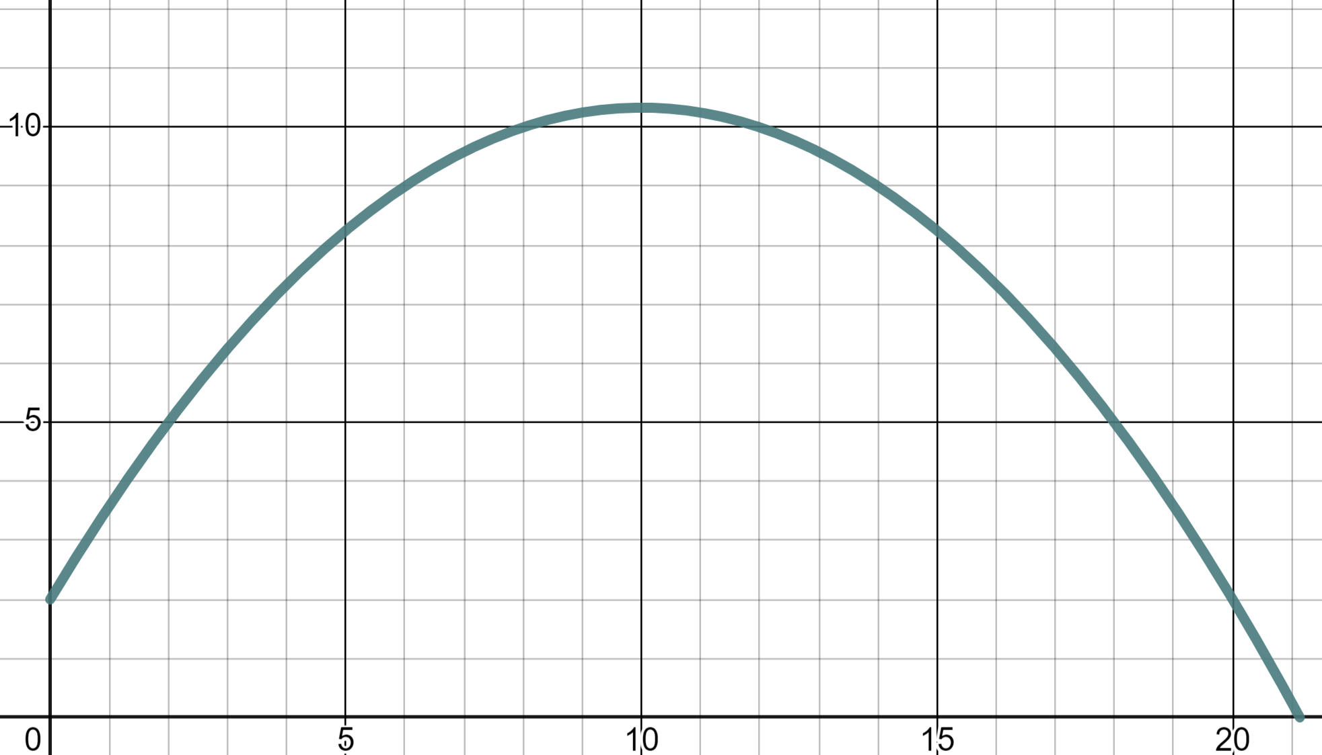
Reading from graphs
2) This parabola models the flight of a cricket ball being thrown.
Use the graph to read:
10
a) The height of the ball at a distance 18 metres.
Height (m)
b) The distance when the ball is at a height of 9 metres.
5
c) The distance when the ball is at a height of 12 metres.
0
5
10
15
20
distance (m)
Mathematics in Education and Industry
v2.3

